Slide 1
What If…? Understanding Part C Eligibility Determination, Assessment and Transition Requirements Through Scenarios
Regional webinars
October & NOvember, 2013
Notes:
Welcome, purpose of session
Survey the room to see whose there … SCs, other EI providers, families, admin. -- Using hat props.
Note cards – write down burning questions so you’re not distracted. If we don’t get to your question today or you don’t want to ask it here, leave it on the table. Can be anonymous if you think it’s something we could address in a Q&A or the monthly Update. Or put your name and email on the card, and I’ll make sure you get a response.

Slide 2
Eligibility, Assessment, IFSP
Initial and Annual
Notes:
Dividing session into 2 parts – ED, ASP, IFSP then Transition

Slide 3

Eligibility Determination
Can eligibility be established by records?
  Diagnosed condition – Service Coordinator
  Documented delay or atypical development – EI Professional
If yes, move to Assessment for Service Planning
If no, move to Eligibility Determination process
Notes:
As child enters system, first question is … Can eligibility be established by records.
These are records that exist at referral

Slide 4
Eligibility Determination
Gather information:
  Use an instrument, cover all areas – ASQ
  Observation
  Child history, parent report
  Medical and other records
Multidisciplinary team reviews information, determines eligibility
Notes:
So, you don’t have records that establish eligibility … now you move to the “full” eligibility determination process.
You need to gather information for the team to use in determining eligibility.
Usually SC (could be an EIP involved).
Once you have the info, a MD team reviews it

Slide 5

Eligibility Determination
Multidisciplinary Team – SC plus 2 disciplines
  What if … there’s an “outside” report?
  What if … SC is also an EIP?
  What if EIP is qualified in more than 1 discipline?
Notes:
When you think about your team, you know SC will be involved (providing info, coord with family).
Regs say, also 2 disciplines involved.
Could be traditional (SC, SLP, ED)
Or, what if you have outside report from a PT? Usually that would come into play because it would establish eligibility and you wouldn’t be at this point of doing a full Eligibility Determination, but maybe there’s a report that shows no delay in one or more areas. Could be SC and ED (because have PT from outside report). SC plus 2 disciplines
What if the SC is also an EIP, maybe an OT. Then … SC/OT hat plus and SLP hat. SC plus 2 disciplines
Or maybe you have an EIP qualified in more than one discipline (like ED and SLP). Then ED/OT hat and SC hat. SC plus 2 disciplines

Slide 6




Eligibility - Multidisciplinary Team
SC
ED
SLP

Slide 7

Team with Outside Report
SC
ED
PT

Slide 8
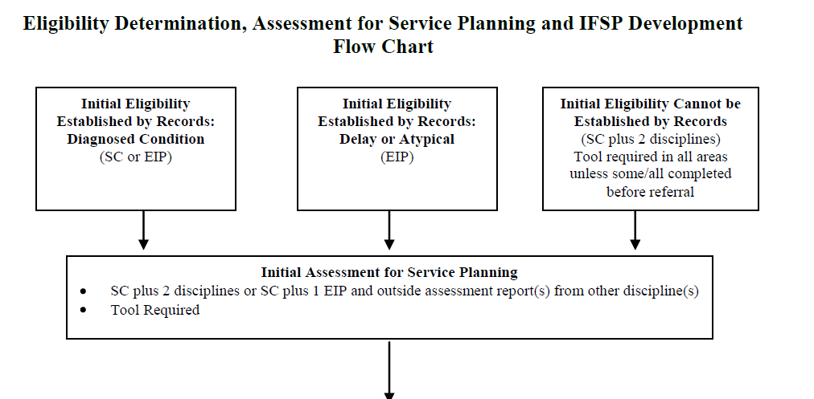
Flow Chart
Notes:
In effort to provide helpful tools to take back with you from this session, I’ve created 2 flow charts. Here’s first look at one of them.
Shows the options for moving through ED and on to ASP

Slide 9
Assessment for Service Planning
Purpose:
  Strengths and needs
  Functional status in 3 child indicator areas
Review available pertinent records
Use a tool as age anchor
Conduct personal observation of child
Notes:
The purpose is …
Three indicators – acquire and use knowledge and skills, positive social relationships, and taking appropriate action to meet needs
Accomplish that by …
Also includes family assessment, but for today we’re focusing on child assessment since that’s where the team issues come into play.

Slide 10
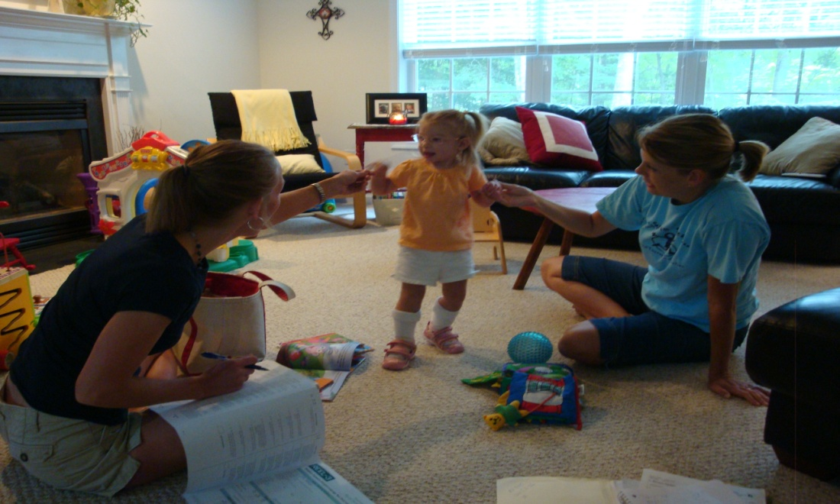
Assessment for Service Planning
Multidisciplinary Team - SC plus 2 disciplines
  What if … there’s an “outside” assessor?
  What if … SC is also an EIP?
  What if EIP is qualified in more than 1 discipline?
Notes:
Just like with Elig Det, the regulations say there has to be a MDT for ASP and it must include the SC plus 2 disciplines.
So, again, this can look a lot of different ways depending on the personnel you have available, whether there is an outside report, whether your SCs serve dual roles, etc.
Some examples … You have outside report from PT, could have SC/Educator or SC and OT
Or if you have an EIP who is qualified in more than one discipline … then Ed/OT and SC
I hope hats are helpful. Gives visual. And you could use this in your local system or Lego People to see who you have and how you can put together teams in the most effective and efficient way in order to meet the requirements.

Slide 11
Assessment - Multidisciplinary Team
SC
OT
SLP

Slide 12
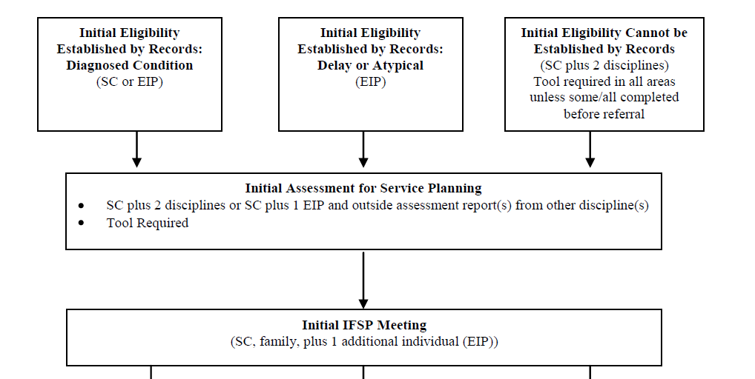
Flow Chart
Notes:
Back to the flow chart … we see for ASP … then on to IFSP

Slide 13
IFSP Meeting
Parent
Service Coordinator
At least one more individual from a discipline other than service coordination.
What if …
  SC is also qualified as an EI Professional
Notes:
Regs say …. Parent, SC, one more individual from a discipline other than SC.
So different from ED and ASP
Also, remember, IFSP team needs to include those involved in ED or ASP, and, as approp, those who may be providing services. So those requirements will impact the group of providers from which you’re choosing
What if SC/OT, then only serving as SC. The other person could be an OT.

Slide 14
IFSP - Multidisciplinary Team
ED
SC
PT
Parent

Slide 15

The Annual Process
Eligibility Determination
  By Records? If not, then
  Full Process (same as initial)
Assessment for Service Planning
  By ongoing assessment? If not, then
  New assessment
IFSP Meeting
  Parent, SC, and one more individual from another discipline.
(Similar to initial)
Notes:
The process for ED, ASP and IFSP at the annual is very similar to those procedures we talked about for the initial.
ED – Same question. IF full process, then Use of tool at annual ED – screening tool, only in areas not covered by ongoing assessment. If you need to use the full ED process, the same participant requirements
ASP --- Keep in mind that the purpose of the annual IFSP is to evaluate the IFSP, not the child. Enough info to know strengths and needs, status in 3 indicators so we can evaluate the existing IFSP outcomes, supports and services and plan appropriate changes. If not enough from ongoing, then same participant requirements as initial. Hat example – ongoing service by SLP but not enough info, bring in ED. Not appropriate to ask providers to do outcomes /goals ahead of the meeting... Collecting info for team to use, just like initial

Slide 16
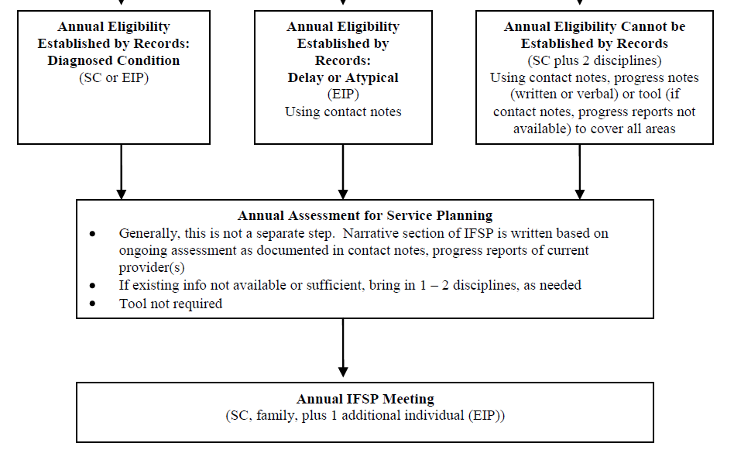
Annual IFSP - Flow Chart
Notes:
Here’s the bottom half of the flow chart we’ve been looking at on other slides. This addresses the steps at the annual.

Slide 17
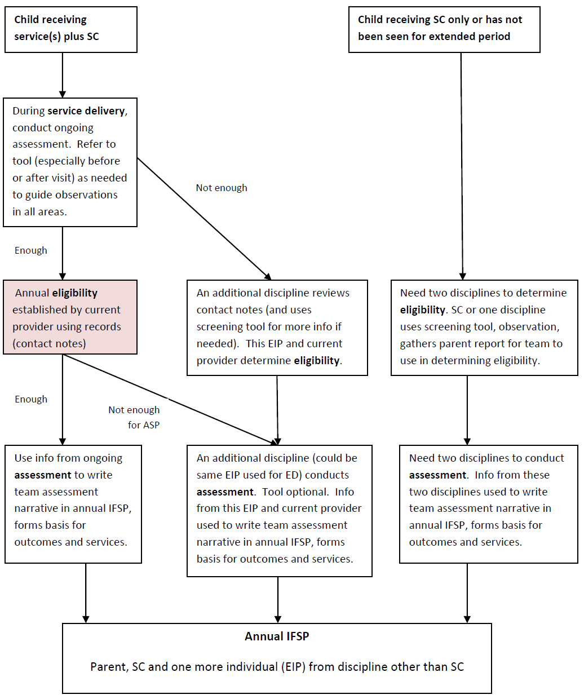
Preparing for Annual IFSP
Flow Chart
Notes:
Here’s the second flow chart. This is designed to assist you in preparing for the annual IFSP based on specific circumstances. Walk through it.
If child has diagnosed condition, enter chart at pink box. Otherwise, you enter the flow chart at the top.

Slide 18

Scenarios
Key information:
- Info at referral
- Info at annual
- Model of SC

Slide 19

Scenario 1:
Initial - Bobby is blind and was referred to the local system at 3 months of age by his pediatrician. The ophthalmologist has provided documentation of Bobby’s visual disability.
Annual - Bobby is receiving service coordination, developmental services twice a month, and vision services once a month. The service coordinator, Joan, is also a certified Early Intervention Professional with a degree in Early Childhood Special Education
Bobby
Notes:
ED – What’s the question? Established by records (diagnosed condition)
ASP – No indication of existing report that meets purpose of ASP so SC plus 2 disciplines.
IFSP – Family, SC, someone else from ASP
Annual ED – Ask question … established by records
Annual ASP – Assume enough
Annual IFSP – Assume Joan is providing the DS, so Family, Joan and provider of vision services (or could’ve been another SpEd, whatever).

Slide 20

Scenario 2:
Initial - Katy is 16 months old and was referred by child care provider because of concerns about language development. Child care provider reports Katy does not talk as much as the other kids her age. Katy’s mom tells service coordinator that pediatrician did a language test at her 9-month check-up and that there were no concerns at that time. Service Coordinator is able to get a copy of the developmental screening completed at Katy’s 9-month well-child visit and it shows no delays.
Annual – Katy is currently receiving service coordination as well as speech-language pathology services twice a month. One visit each month is at home with Katy and her mom and other visit is at day care with Katy and her child care provider. Based on ongoing assessment, SLP knows Katy’s language skills are at 18-20 month age level and that language delays are impacting Katy’s social interactions with the other children at day care. In other areas of development, Katy is at age level.
Katy
Notes:
ED – What’s the question? Not established by records (can’t establish ineligibility by records). SC plus 2 disciplines
ASP – SC plus 2 disciplines
IFSP – SC plus someone involved in ED and/or ASP
Annual ED – What’s the question? Established by records (contact notes)
Annual ASP – Assume enough from ongoing assessment
Annual IFSP – Family, SC, SLP

Slide 21

Scenario 3:
Initial - Cole was referred to local system at 3 months old after being evaluated at Children’s Hospital of the King’s Daughters (CHKD) and found to have delays in gross & fine motor development. Written report from CHKD indicates delays of over 25% in each of these 2 areas and describes skills Cole is able to demonstrate consistently as well as those he is not yet using in these areas.
Annual - Cole’s initial IFSP listed service coordination, PT once/week and OT once/month. At IFSP Review held 6 months ago, team reduced PT to once/month since Cole had made significant progress and his mother was comfortable implementing strategies during daily routines, activities. Shortly after IFSP Review, family member was diagnosed with serious illness & Cole and his family were not available for visits. It’s been 4 months since a provider has seen Cole, but his mother has indicated things have settled down now. She would like to schedule the annual IFSP meeting.
Cole
Notes:
Elig – What’s the question? Est. by records, documented delay
ASP – Any records that can used? Yes … info in report is relevant to ASP. One other assessor.
IFSP – Family, SC, plus assessor
Annual ED – First we ask? Need to do (probably PT and OT)
Annual ASP – need to do (probably PT and OT)
Annual IFSP – PT and/or OT
ANY QUESTIONS ABOUT THIS PART OF SESSION? TAKE A LETTER TILE. Example: S = SC in dual role can only fill one of the required participant roles in IFSP meeting.

Slide 22
Transition
Transition Plan
Notification
Transition Conference

Slide 23

Our Anchor
Support smooth transitions for children and families
Notes:
As we talk today about the transition requirements and figuring out how to implement and document those requirements, I think it’s important to remember that the purpose behind the federal and state requirements related to transition and behind the transition section of our IFSP is to ensure children and families receive the support they need for a smooth transition when they’re leaving EI. That purpose should be what anchors us, what we come back to, when we’re trying to figure out how to implement the requirements for transition

Slide 24

The Federal Requirements
Transition Plan – Part of the IFSP.
Notification (and referral)
Transition Conference
Notes:
Transition Plan – The Table in Section VII of our IFSP Form. Must include: Procedures to prepare child for changes in service delivery, new setting. Discussions with and training of families about future placements.
Addresses plans for notification and conference.
Notification to LEA and SEA – is a referral
Transition Conference - intended to give the family more specific information about the services their child may receive in the next program.
And just a final note on the federal regulations … a meeting is required in order to develop the transition plan and a meeting is required in order to hold the transition conference. They can be combined into one meeting. Whether combined or held separately, these meetings have to meet the requirements for an IFSP meeting. So either the transition plan and transition conference happen as part of an initial or annual IFSP or as an IFSP Review meeting

Slide 25
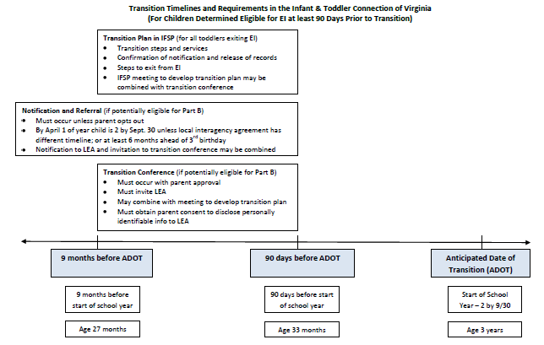
Transition Diagram
Notes:
There are timeline associated with each of these three components of transition.
This shows the steps and how they fall along the timeline leading up to the ADOT. In Virginia, the ADOT is usually 2 or 3.

Slide 26
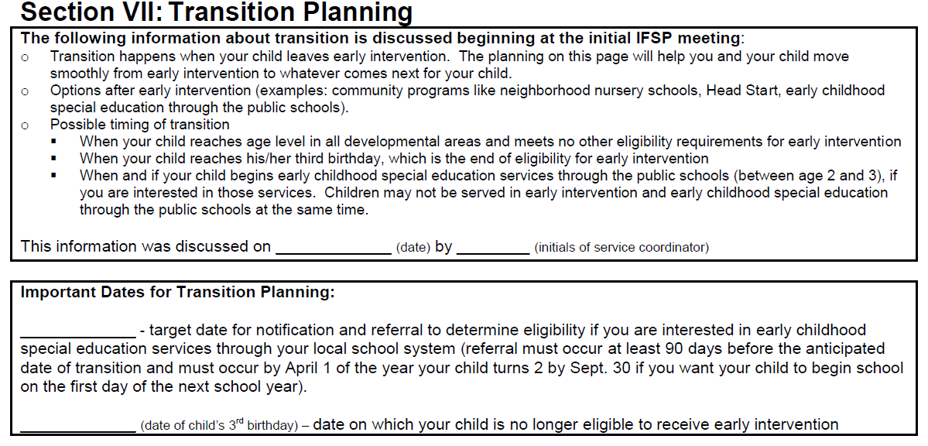
Top Two Boxes
Notes:
Let’s look at the transition section of the IFSP, which is where we document a lot of needs to happen related to transition.
Top 2 boxes - For all children
Generally shared at initial IFSP meeting
1st box – explains what transition means and possible timing
2nd box gives important transition dates for this specific child and family. The purpose is to give the family an idea about when transition might occur. There is no commitment here … it doesn’t matter whether the family is interested in going to Part B or how old the child is. You’re saying … Just to give you an idea, if you decide you’re interested in preschool services through the school system, then in Virginia your child would be age eligible at the start of the school year in 2014 and we would need to be notifying the local school system by April 1 of that year. Otherwise, if your child remains eligible for EI services, then he could continue to receive those services until his third birthday. As your child gets older we’ll talk more about your specific plans and figure out exactly where in this window of time transition will actually happen.

Slide 27

Calculating Target Date in 2nd Box
At least 90 days before start of school year
Usually April 1
Notes:
Federal requirements tell us that notification and referral have to happen at least 90 days before the anticipated date of transition (in this case, the start of the school year).
The state interagency agreement that we have with the Department of Education in Virginia says that the notification and referral must happen by April 1st of that year when the child will be 2 by September 30.
So, unless you have a local interagency agreement with the school system that has a different notification and referral deadline, the target date you enter here will generally be April 1 of the year the child turns 2 by September 30.
Otherwise, the only exception to April 1 would be if the child was referred to EI after April 1 of the year when the child would be age eligible to start preschool services under Part B.

Slide 28
Transition Plan
For all children
90 days to 9 months ahead of transition
Steps and activities completed will depend on family’s specific transition plans and preferences
Use N/A if activity is not applicable
If family chooses not to complete an activity, note that in the blank
Notes:
The table below the 2 boxes is the Transition Plan. Take a look at that now on your copy or electronic device.
Review info on slide
Talked about having a meeting to develop the transition plan -- Don’t have to fill in all steps at the meeting to develop the plan.

Slide 29
Transition Steps
Potentially Eligible for Part B
Not Potentially Eligible for Part B
Step 1
Step 2
Step 3 – maybe
Step 4
Step 5
Step 6
Step 1
Step 3
Step 5
Step 6
Notes:
Need to look at each of these steps … may find parent not interested in some; some parts may be NA depending on parent’s choices. We’ll look at these steps more carefully as we walk through some scenarios in a few minutes.

Slide 30

Anticipated Date of Transition
Start of school year when child is age eligible (2 years old by Sept. 30th)
-OR-
Third birthday
Notes:
When you start planning transition, you’re usually going to be working from one of two transition dates – the start of the school year when the child starts school or the child’s third birthday

Slide 31

Anticipated Date of Transition (continued)
Document which one you’re using in a contact note or on IFSP
Start of school year - Estimate and pick a date (usually start last week of August … Pick a date that week). Document it!
Document if family changes their mind
Notes:
You’ll want to document which one you’re using – either in a contact note or on the IFSP (write it anywhere or type it in somewhere like 1c)
If you’re using the start of the school year – document that’s what you’re doing and your estimate of what that date will be. If school usually starts the last week of August, then pick a date from that week.
You’ll also document (in a contact note) if the family changes their mind about when they’d like to transition.

Slide 32
Anticipated Date of Transition (continued)
Remember our anchor ….
Documentation will show what dates you planned around
Looking for correct “window” for planning
If family changes their mind and now the required activities occurred outside timelines
  Use the ATOD that makes sense
  Use family preference as mitigating circumstance
Notes:
I know you worry about monitoring and record reviews and being out of compliance based on the required timelines and the anticipated date of transition. This is one of those times where we’re all going to remember our anchor. The reason we have the requirements is to ensure support to children and families for a smooth transition.
Talk from slide.

Slide 33
Transition Conference
Part B
Other
Required, with approval of family
90 days to 9 months ahead
Family, Part C, Part B (must be invited)
Discuss any services child may receive under Part B
Make reasonable effort, if parent approves
No timelines specified
Family, Part C , providers of other appropriate services
Discuss appropriate services child may receive
Notes:
Let’s look at the difference between a transition conference when the child is potentially eligible for Part B (and the parent is interested in Part B) vs. a transition conference when the child is not potentially eligible or the parent is not interested.
Talk from slide.
If other, note in 1a or c, 3c or 5b

Slide 34
Meetings
Transition Plan
Transition Conference
For all children exiting, regardless of age
Comprehensive planning
Only required if potentially eligible for Part B
Includes Part B or other program
Information about that new program
Notes:
I mentioned earlier that there are two kinds of meetings that happen as part of the transition. There is a meeting to develop the transition plan and a meeting for the transition conference. I also said that the federal regulations allow that these can be combined into one meeting. To help you think about the differences between the two meetings so that you can decide whether there are times that it makes sense to combine them, I’ve got this slide.
To me, the meeting to develop the transition plan is going to be more comprehensive … you’re going to be reviewing the steps and activities on the IFSP to give families a complete picture of the transition steps and the kinds of supports available through that process. And you’re going to be identifying at least the first few activities that you’ll be completing in the transition plan.
The conference, on the other hand, is focused on the services the child may receive in the next program.
It might make sense to combine the two and essentially accomplish at least part of Step 1a by having a program(s) share information (accomplishing the transition conference) during the meeting to develop the transition plan. This might work well for a family that’s pretty sure they already know what program they want to transition to.
On the other hand, a family with no idea, who is really just starting to find out about options after EI might be better off starting with a meeting to develop the transition plan, where you identify the programs they want to explore further and the later hold a transition conference when they have a better idea that they want to go to Part B.

Slide 35

Scenarios
Anticipated date of transition
Family choices and preferences

Slide 36
Scenarios:
Bobby’s parents plan to have him transition to local school system to start preschool special education services at the start of the school year after he turns two in June
Katy’s mom initially thought she wanted Katy to go to public schools at age 2, but she changed her mind and decided to wait until closer to age three to see if she caught up. She did not want a referral sent to the local school system. As Katy got close to age three, her mom decided to just continue using day care rather than send her to school or use other services (even though Katy did not catch up in all areas).
At 18 months old, Cole’s parents and his providers feel he has caught up. Cole’s parents do not want another eligibility determination and feel he is ready to leave early intervention
Bobby
Katy
Cole
Notes:
Any questions about transition? Letter tiles for a reminder point! Example -

Slide 37
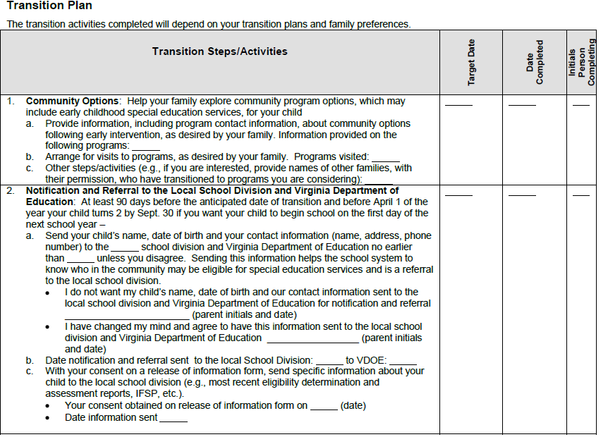
Transition Plan

Slide 38
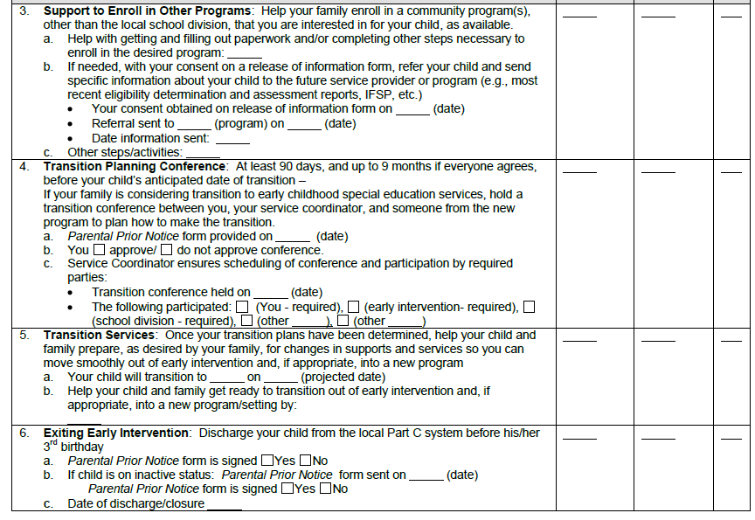
Transition Plan
Notes:
Letter tiles, questions

